Slide 1
Poptato Cinema
A micro-service based solution

Slide 2
We’re On GitHub
Visit the project on:
https://github.com/Poptato

Slide 3
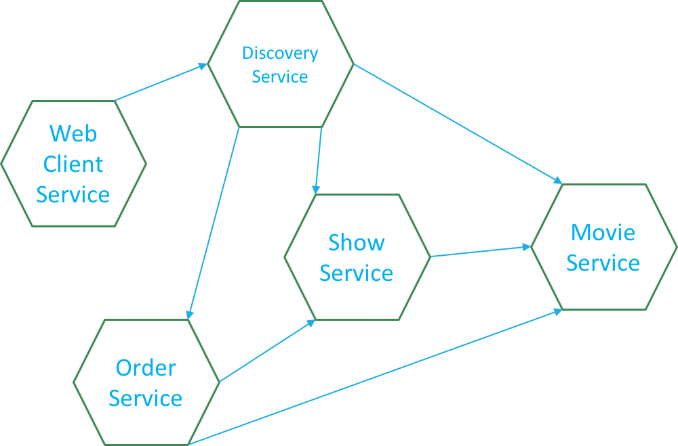
The Micro-Services

Slide 4
Technologies

Slide 5
Development & Testing

Slide 6
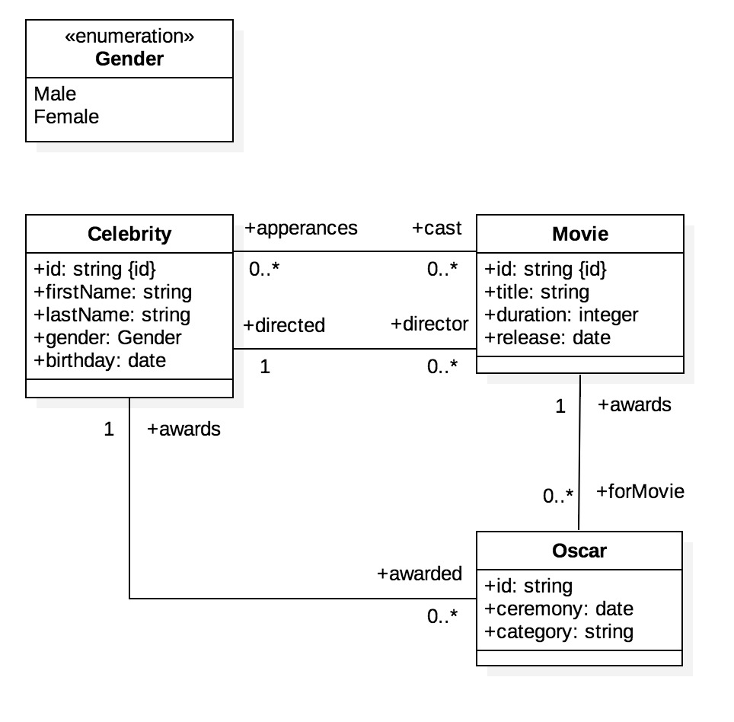
Movie Service
A movie has many cast members (celebrities)
A Movie has one director (celebrity)
A movie has many Oscar awards.

Slide 7
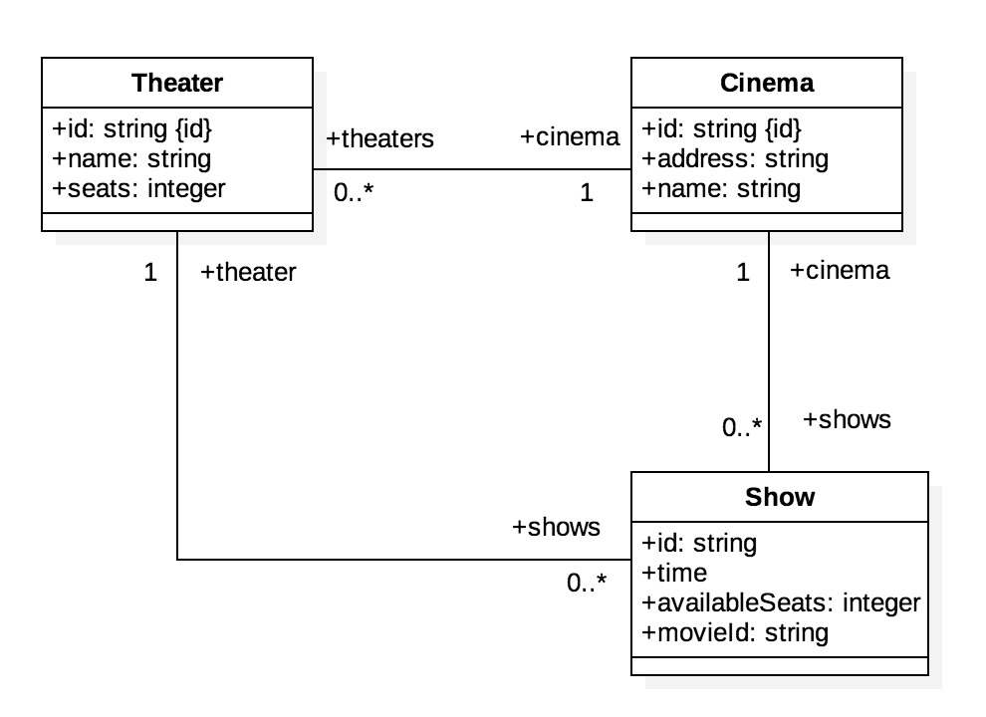
Show Service
A cinema has many theaters
A theater has many shows

Slide 8
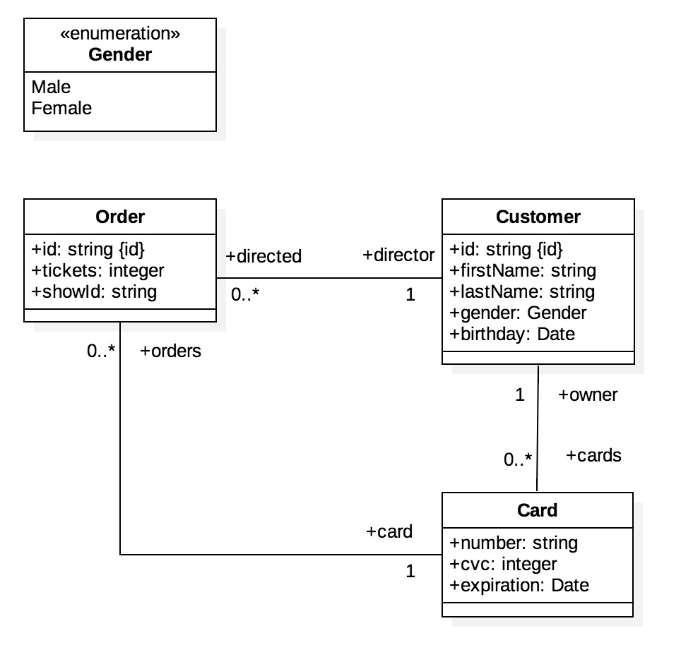
Order Service
A customer has many orders
A customer has many cards
An order has one card

Slide 9
Demo

